Slide 1


emGiBot! the World’s first Voice Assistant that sees you!
Emanuele Alessi
Gianmarco Forcella

Slide 2
Introduction
Intelligent Personal Assistant are expanding and becoming clever (Alexa, Siri…)
We wanted to create something that could see and interpret gestures
Something as a «Proof of Concept»
Notes:
Why Adam:
It is easy to implement;
It is computationally efficient;
It requires a small amount of memory;
It is invariant to the diagonal rescale of gradients.

Slide 3
emGiBot!
Multimodal Interactions involved:
Speech Interaction
Speech Recognition
Speech Communication
Gestures
Computer Vision
Notes:
Why Adam:
It is easy to implement;
It is computationally efficient;
It requires a small amount of memory;
It is invariant to the diagonal rescale of gradients.

Slide 4


Compartmentization
Components that were built for emGiBot!
Speech Recognition
Natural Language Understanding
Hand Tracking
Notes:
Why Adam:
It is easy to implement;
It is computationally efficient;
It requires a small amount of memory;
It is invariant to the diagonal rescale of gradients.

Slide 5
Compartmentization - NLU
An open-source natural language processing tool for intent classification, response retrieval and entity extraction in chatbots
Notes:
Why Adam:
It is easy to implement;
It is computationally efficient;
It requires a small amount of memory;
It is invariant to the diagonal rescale of gradients.

Slide 6
Compartmentization – Hand Tracking
An open source computer vision and machine learning software library. OpenCV was built to provide a common infrastructure for computer vision applications.
Notes:
Why Adam:
It is easy to implement;
It is computationally efficient;
It requires a small amount of memory;
It is invariant to the diagonal rescale of gradients.

Slide 7
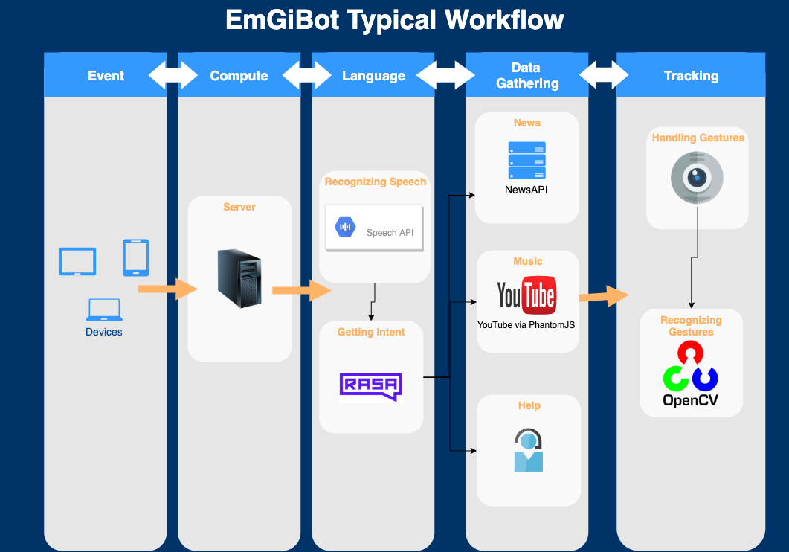
Workflow
Notes:
Why Adam:
It is easy to implement;
It is computationally efficient;
It requires a small amount of memory;
It is invariant to the diagonal rescale of gradients.

Slide 8
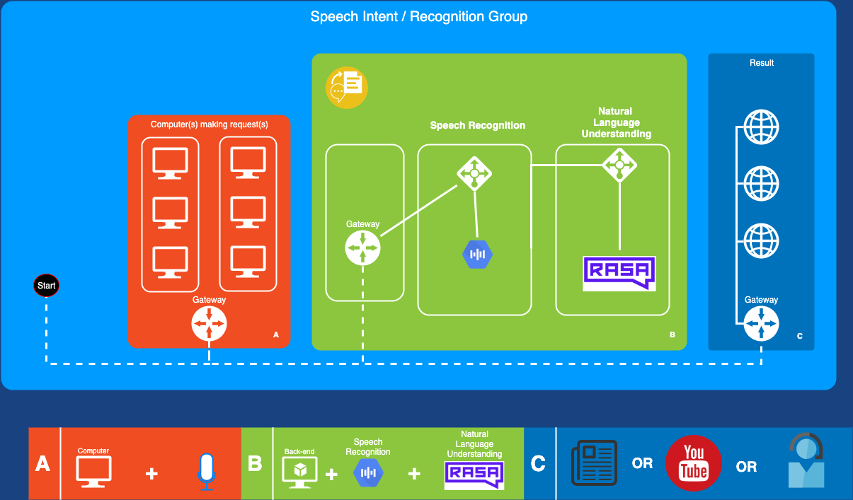
Speech Interaction
Notes:
Why Adam:
It is easy to implement;
It is computationally efficient;
It requires a small amount of memory;
It is invariant to the diagonal rescale of gradients.

Slide 9
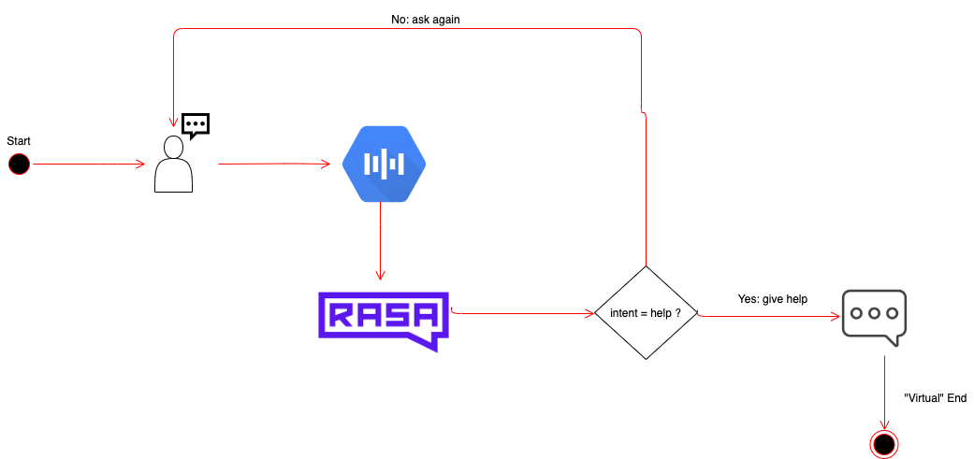
Help
Notes:
Why Adam:
It is easy to implement;
It is computationally efficient;
It requires a small amount of memory;
It is invariant to the diagonal rescale of gradients.

Slide 10
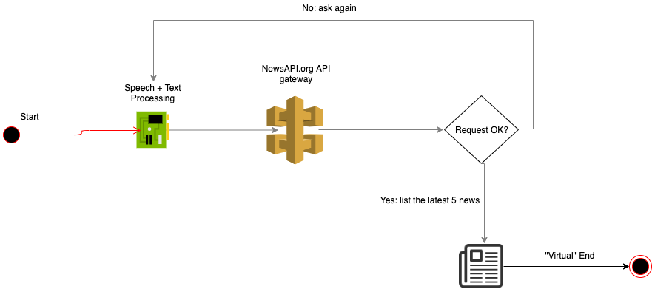
News
Notes:
Why Adam:
It is easy to implement;
It is computationally efficient;
It requires a small amount of memory;
It is invariant to the diagonal rescale of gradients.

Slide 11
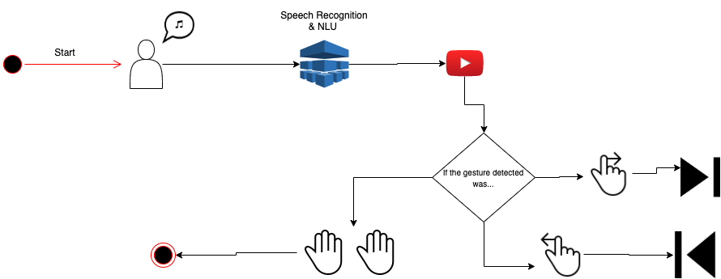
Music
Notes:
Why Adam:
It is easy to implement;
It is computationally efficient;
It requires a small amount of memory;
It is invariant to the diagonal rescale of gradients.

Slide 12
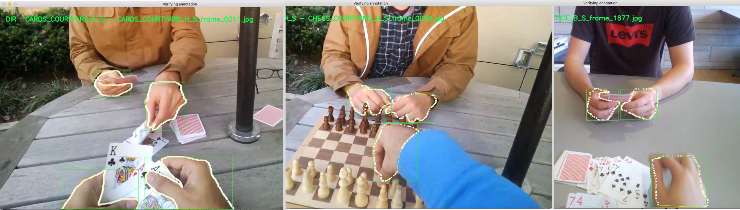
Hand tracking
Neural approach (MobileNet + transfer learning)
The Egohands Dataset
15000 (and more) ground truth labels (ROI)
4800 images
Notes:
Why Adam:
It is easy to implement;
It is computationally efficient;
It requires a small amount of memory;
It is invariant to the diagonal rescale of gradients.

Slide 13
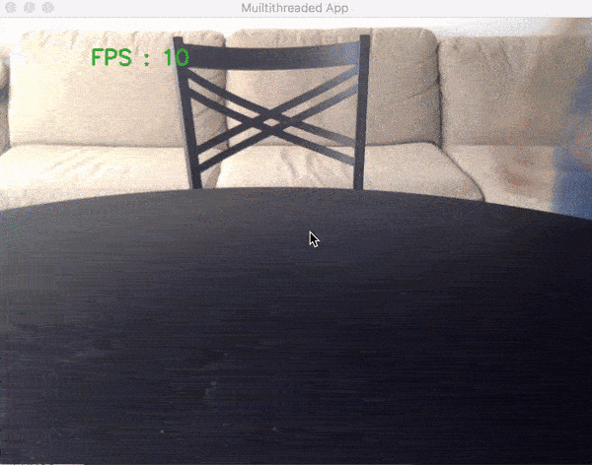
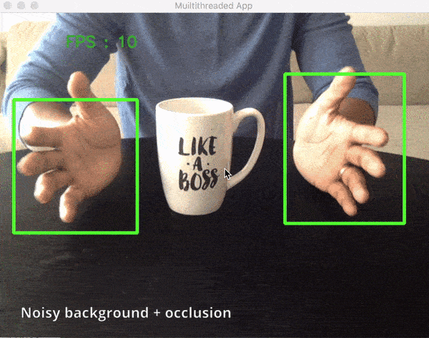
Hand tracking
Notes:
Why Adam:
It is easy to implement;
It is computationally efficient;
It requires a small amount of memory;
It is invariant to the diagonal rescale of gradients.

Slide 14
Tech Demo
Notes:
Why Adam:
It is easy to implement;
It is computationally efficient;
It requires a small amount of memory;
It is invariant to the diagonal rescale of gradients.

